Slide 2
Solution-Focused Brief Therapy
“I don’t lead musicians, man. They lead me. I listen to them and learn what they do best.”
~Miles Davis

Slide 3



First Interview With Rosie

Slide 4
About the Training
Purpose
Background Information
Agenda
Directions of Focus
General SFBT Information
SFBT Skills & Experiential Learning
SFBT & Practice
SFBT & Other Treatments

Slide 5
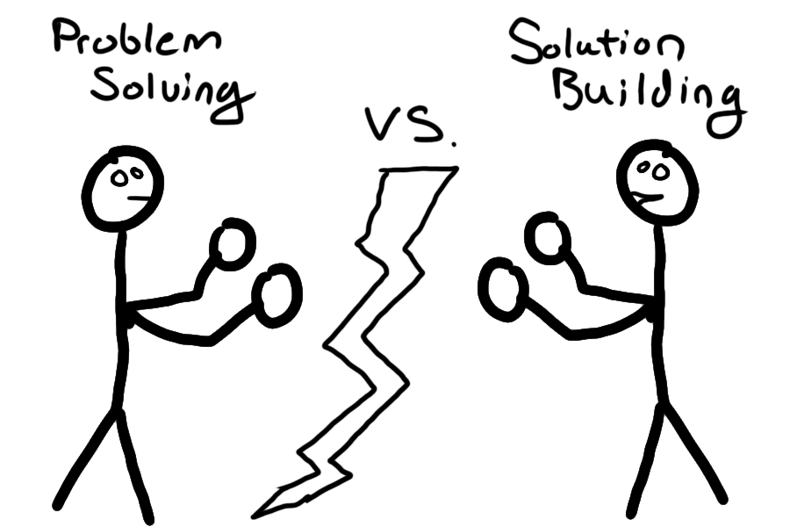
Two Types of Helping

Slide 6


Direction of Focus

Slide 7

SFTB Introduction

Slide 8

SFBT Introduction

Slide 9
About SFBT
History
Steve de Shazer, Insoo Kim Berg, and their colleagues developed Solution-Focused Brief Therapy starting in the late 1970’s
Utilized in business, social policy, education, criminal justice services, child welfare, and domestic violence offender treatment

Slide 10
About SFBT
Tenets
If it’s not broken, don’t fix it
Look for exceptions
Asking questions rather than telling clients what to do
Future is negotiated and created
Complements
Gentle nudging to do more of what is working
Change is constant and inevitable
The solution is not always directly related to the problem

Slide 11

SFTB Skills Overview

Slide 12

SFBT Skills Overview

Slide 13
SFBT Interventions
Interventions
Not knowing
Complementing strengths
Scaling questions
Exception questions
Coping questions
Miracle question

Slide 14
SFBT Interventions
Not Knowing
Clients experts
General attitude communicating an abundant, genuine curiosity
Micro practice skills

Slide 15
Experiential Learning
With a partner:
Ask them what their favorite activity is, and elicit details.

Slide 16
SFBT Interventions
Complementing Strengths
Strengths perspective
Building rapport and giving hope
Direct complements: positive evaluation or reaction
Indirect complements: a question implying something positive

Slide 17
SFBT Interventions
Scaling Questions
Uses in other techniques
Motivation, hopefulness, depression, confidence, progress… etc
Techniques for follow-up

Slide 18
SFBT Interventions
Exploring Exceptions
Problem description vs. exceptions
Increase awareness of current/past successes
Turning past solutions into present solutions
Finding out specifics
Creating a plan

Slide 19
SFBT Interventions
Coping Questions
Tailored to help client from feeling overwhelmed
A method for exploring exceptions
Finding the clients strengths

Slide 20
SFBT Interventions
Miracle question
Amplifying what the client wants
Formatting the question
Concrete, behavioral, measurable terms
Realistic terms

Slide 21
Experiential Learning
Think about a difficult client to work with. Interview you partner.
Implement a stance of not knowing
Use the miracle question to come up with a goal of being a better clinician.
Explore for strengths and complement them.
Elicit exceptions and coping methods for creating a plan.
Utilize scaling questions.

Slide 22
Second Interview with Rosie
Read and discuss the second interview with Rosie.

Slide 23
Connecting SFBT to Practice
Building rapport
Co-created treatment goals
Creative plans
Individual meetings
Reviewing treatment goals

Slide 24
Connecting SFBT to other Techniques
Strengths perspective
Motivational interviewing
Micro practice skills
Client as expert
Contrast to medical model
Anchored in change

Slide 25
Questions, concerns, or comments
?

